Slide 1
Project – Old Book Store
By Group 8
Team Leader-Anuj Tripathi MCA3B
Team Member(1)-Aayush Awasthi MCA 3B
Team Member(2)-Ramji Gupta MCA3B
Project Supervisor-Dr. Amit Kumar

Slide 2
Introduction
An online Old Book Store project that acts as a central database containing various books in stock along with their title and cost. This project is a website that acts as a central old book store.
A user visiting the website can see a wide range of books.
The user may select desired book and view its price. The user may even search for specific books on the website.

Slide 3
Technologies And Software Requirements
Front End Technologies - JavaScript , HTML , CSS
Back End Technologies - Python , JavaScript , MySqlite
Framework – Django
Software Required – Windows 8,10

Slide 4
Hardware Requirements
Intel Core i3/i5 Processor,
Hard Disk – 50 GB
Memory – 4GB RAM

Slide 5
Modules
Registration / Login
Add to Cart
Searching for book
Buy book
Payment option

Slide 6
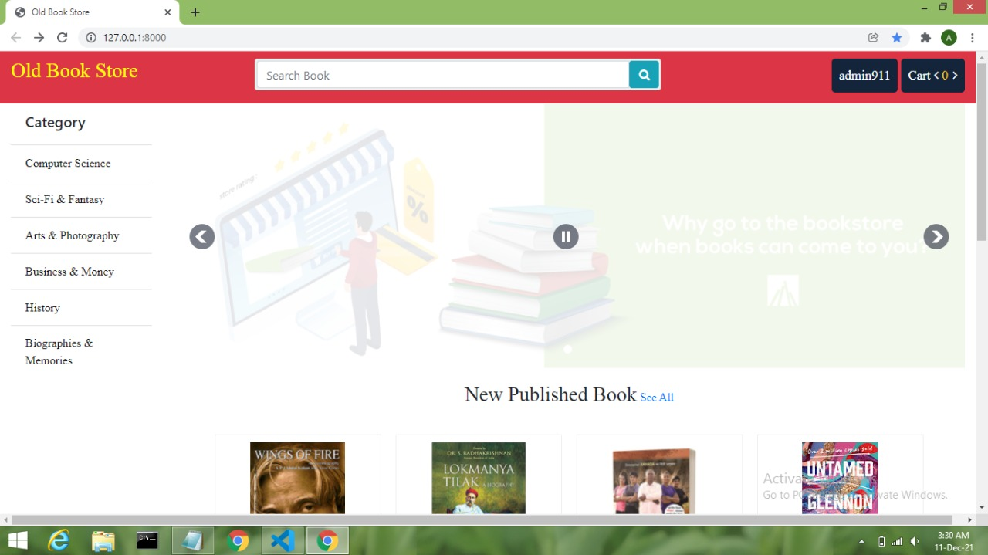

Slide 7
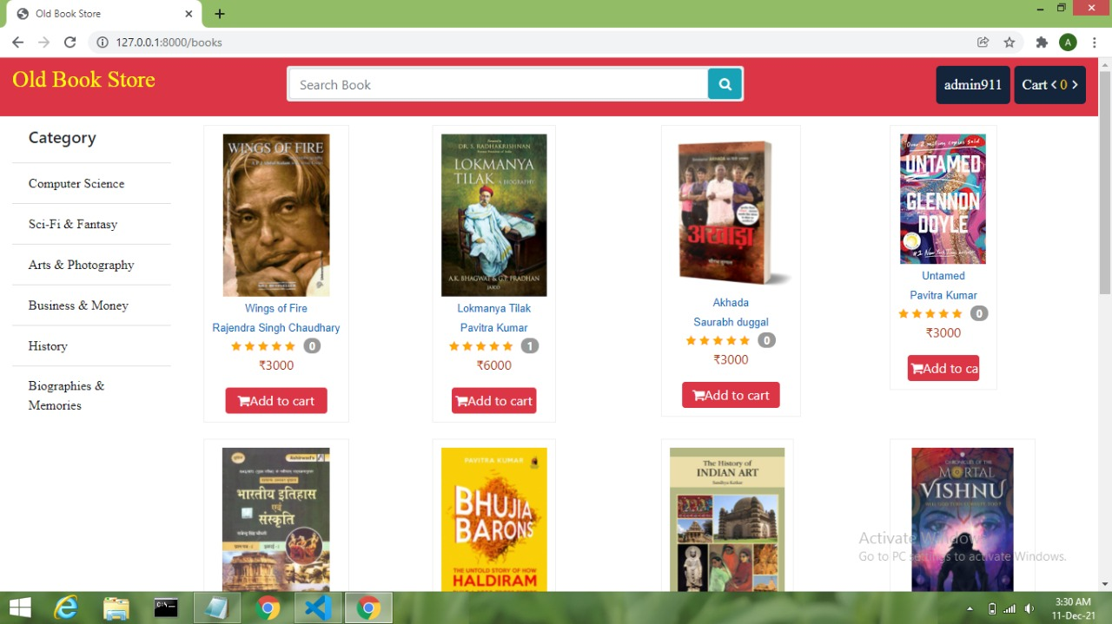

Slide 8
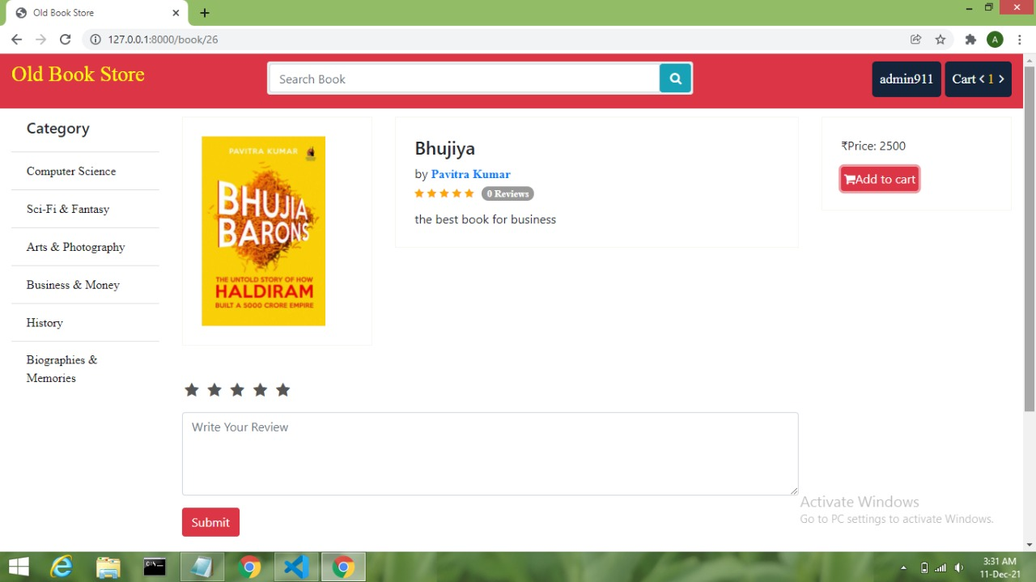

Slide 9
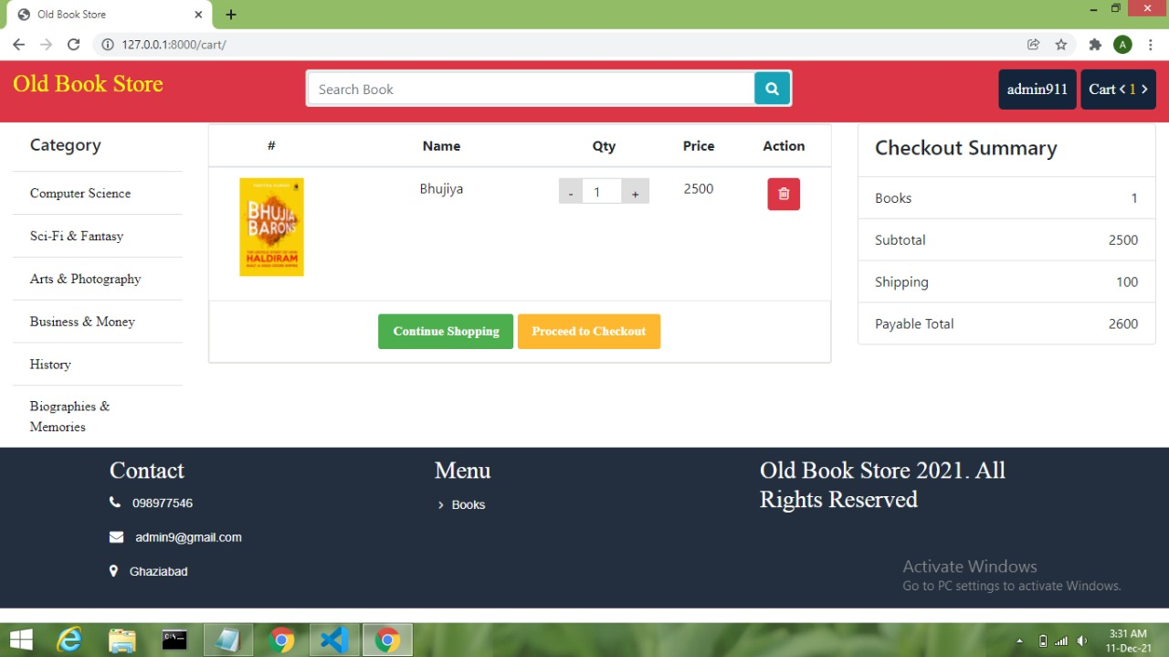

Slide 10
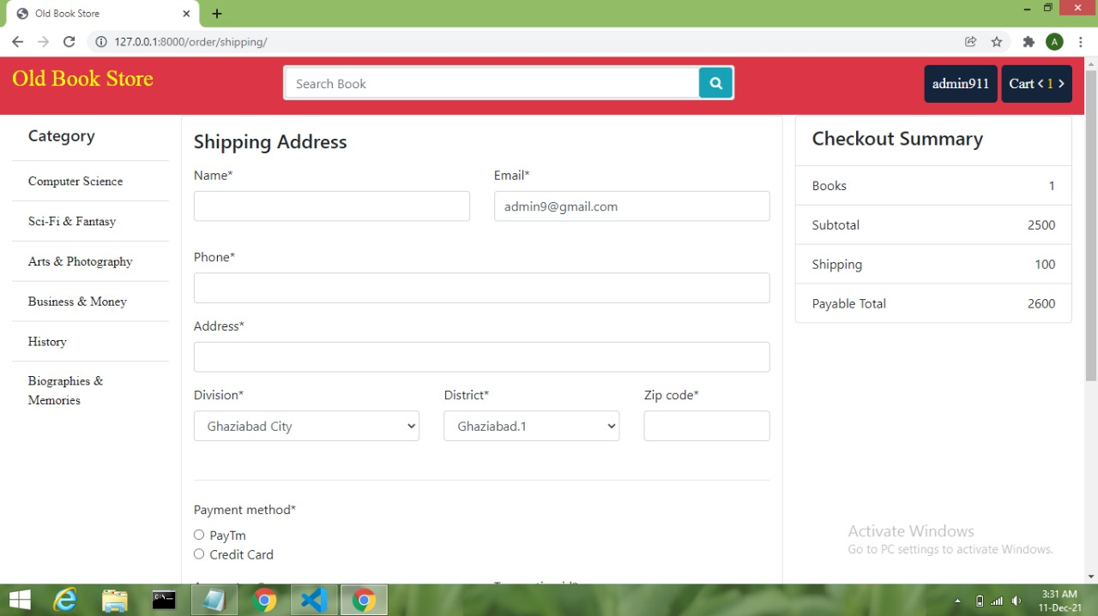

Slide 11
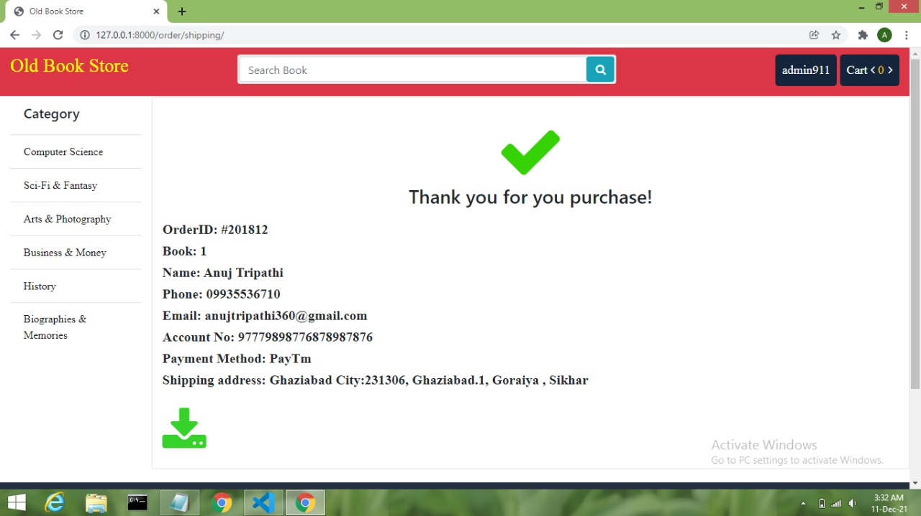

Slide 12
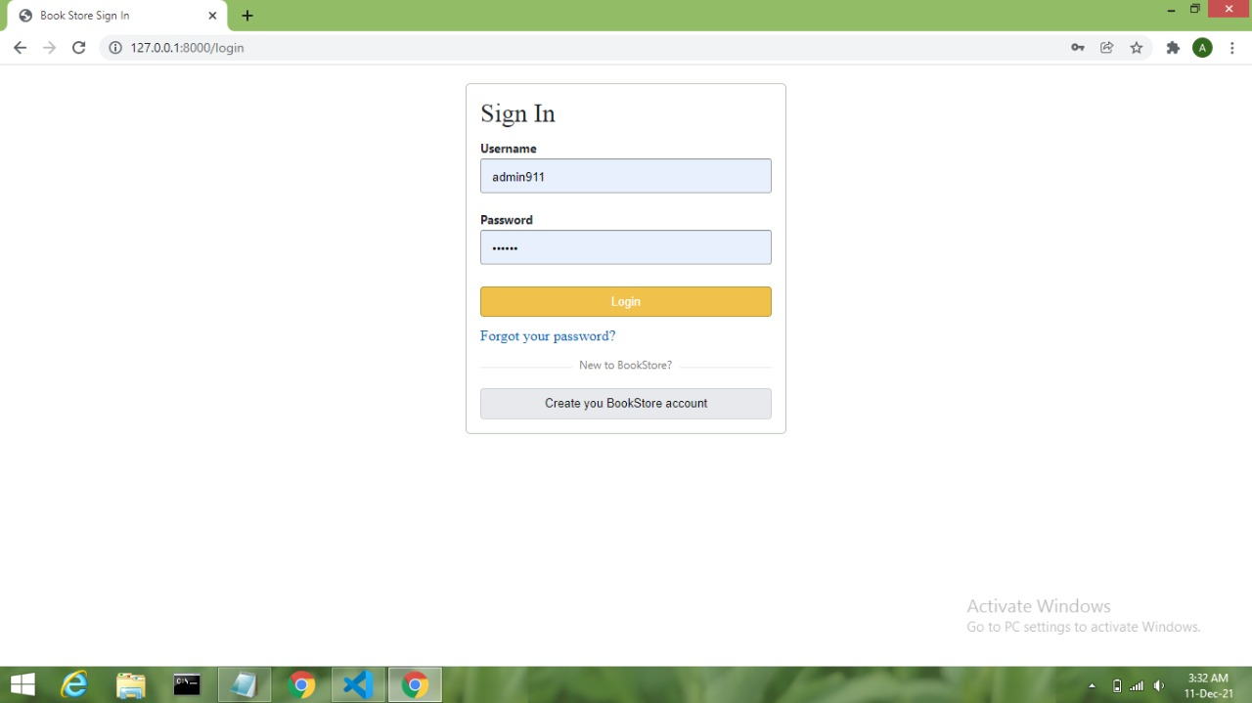

Slide 13
Conclusion
The Internet has become a major resource in modern business, thus electronic shopping has gained significance not only from the entrepreneur’s but also from the customer’s point of view. For the entrepreneur, electronic shopping generates new business opportunities and for the customer, it makes comparative shopping possible. As per a survey, most consumers of online stores are impulsive and usually make a decision to stay on a site within the first few seconds. “Website design is like a shop interior. If the shop looks poor or like hundreds of other shops the customer is most likely to skip to the other site”. Hence we have designed the project to provide the user with easy navigation, retrieval of data and necessary feedback as much as possible. In this project, the user is provided with an ecommerce web site that can be used to buy books online.

Slide 14
How we serve the society.
We target the students or the learners who don’t have that much money to buy a new books.
With the help of our website we provide them the old and used book online which they can buy easily.

